Slide 1
Capstone Pitch
The Potential for Data Science in Retail by Elke Hansen

Slide 2
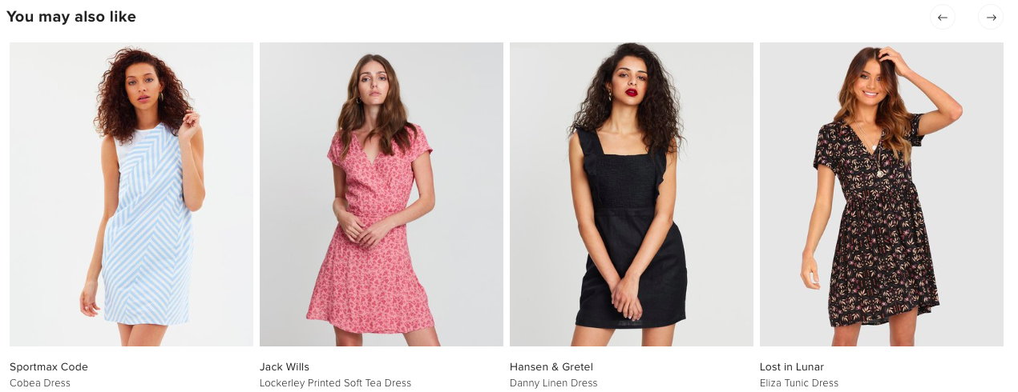
Project 1 - Recommendation Engine

Slide 3
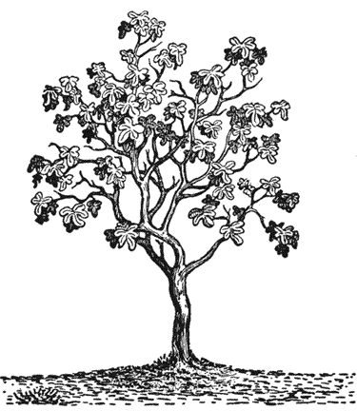
Problem Statement
Customers have too many choices in a modern retail market
There is a strong need for taste curation
How can retailers use data to improve user experiences, create customer satisfaction and retain brand loyalty?

Slide 4
Beneficiaries of these models
Within Retail industry:
Used for targeted marketing both on websites and in EDMs and social media
Significantly increases revenue, email click through rates and conversions
Reduces customer churn
Outside of Retail:
Currently being used by media companies to curate customer experience. Netflix, Spotify etc.
Transport and logistics industry use for operations planning
Energy and utilities companies for customer experience management

Slide 5
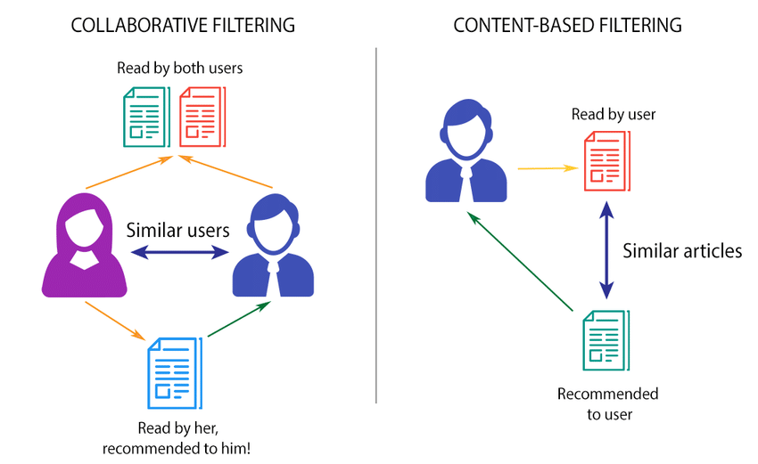
A Path to Success
Exploration of data to determine which method of filtering will work the best.
A hybrid of both is preferred
Cluster the users or items based on their feature similarity (KNN)
Scale item ratings by the user’s value, such as average transaction value
Be able to predict a customers preferences to a degree of accuracy
Test the model based on coverage, the percentage of items the model is able to recommend from a test set
Personalisation is used to check that model is recommending different items to different users

Slide 6
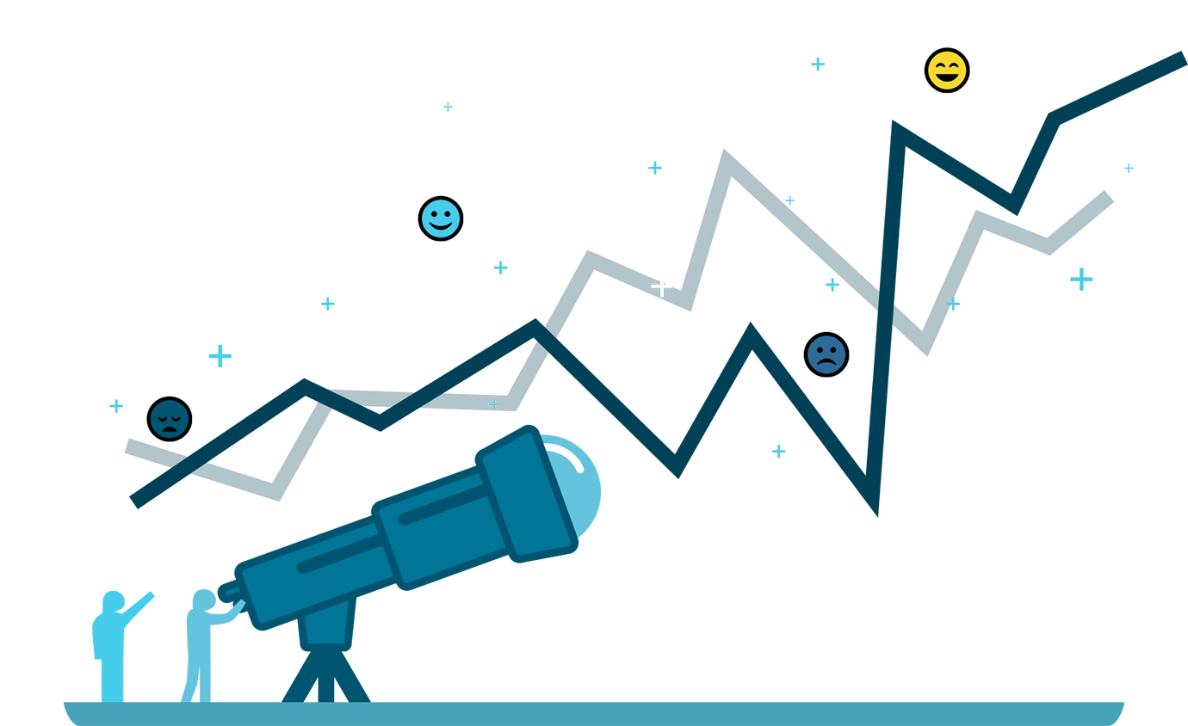
Project 2 - Sales Forecasting Model

Slide 7
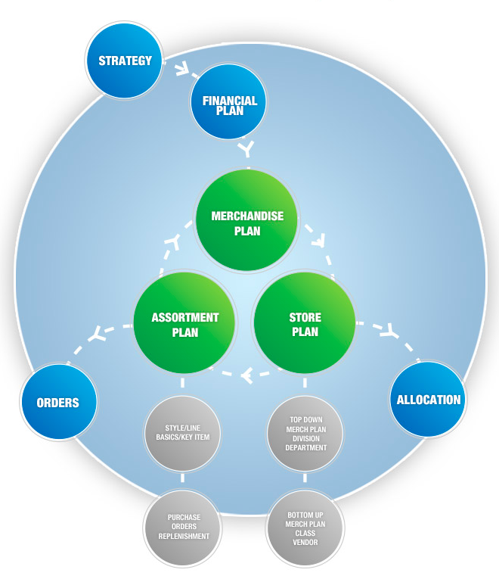
Problem Statement
Retail companies are continuously introducing new ranges into the market
It is difficult to know which attributes (aside from colour) will be the contributing factor to sales
What is the optimum quantity of new season items to purchase for stores?

Slide 8
Industries
Sales Forecasting is used in all industries in one way or another

Slide 9
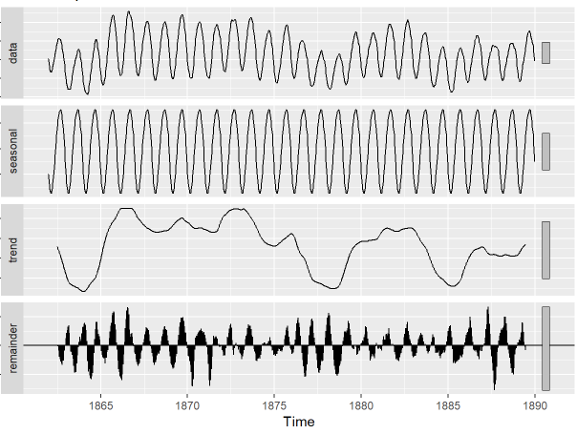
Strategy and Goals
Highlight the most influential attributes on sales
Use of time series analysis to predict future volume of sales
Know when to drop old data to keep sales information and trends relevant
Visualise using time series decomposition to differentiate between seasonality and overall trend
FB forecasting tool Prophet
Be able to plug in details of a style/item and be able to know exactly how many to buy
Cross validation and calculation of R squared
Continuous trial and error to find the best type of model

Slide 10
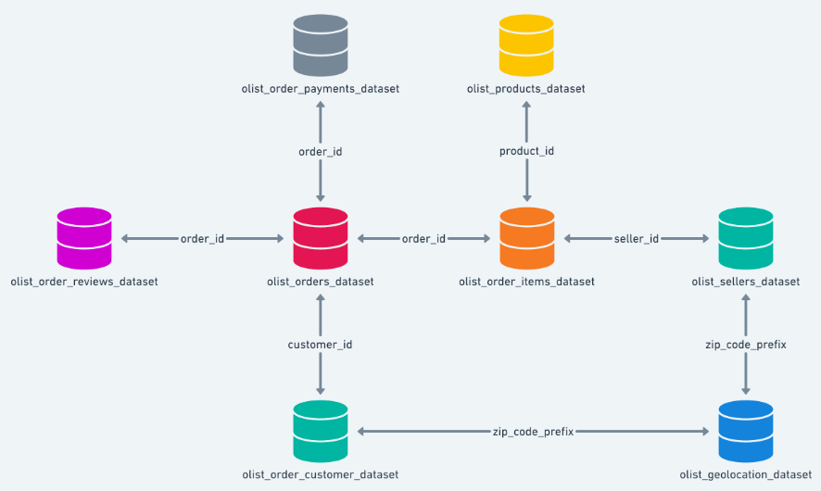
Data Sources
All from Kaggle:
Brazilian E-Commerce Public Dataset by Olist - Schema shown
E-Commerce Data - has sales information but not many columns or useful info
Women's E-Commerce Clothing Reviews - would be great for a NLP type of recommendation engine

Slide 11
Future Potential
Sales forecasting by size, location, customer
Recommendation to assist with sales and marketing
NLP Model to predict trends in social media
Image recognition for classification of garments
NLP Model to recognise customer dissatisfaction and reduce churn
Combination of Models

